Slide 1

MIS 281N
Data Management
Class 3 – Designing a Database
Brad Poynter
Clint Tuttle

Slide 2
Goals for tonight
1st part:
DDL with Insert, Update, Delete, Sequences (~45 minutes)
Debrief starting at 4:45pm
Short Break
2nd part:
DML basics (SELECT, FROM, WHERE, ORDER BY)
Debrief starting at 5:30

Slide 3
Tips for 1st part (DDL & Implement)
Column level constraints only apply to that 1 column. Constraints that involved two columns have to be defined at a table level.
Uses single quotes for data, not double quotes. Don’t need double quotes
Order of CREATE (parent before child) and DROP (child before parent)
DEFAULTs only get used when a value of NULL is entered. Therefore you shouldn’t constrain these columns with NOT NULL. If you include that, you'll never allow NULL which means the default will never be used.
In Debrief
When do we need ALTER versus DROP/CREATE
Common areas of confusion from FA21
HW3 - PK is not the same as FK. We need to know this when we put indexes on FK
Where should we place indexes (proactively) and where (reactively)

Slide 4
DDL Data Definition Language

Slide 5
DDL = Data Definition Language
We can define a table’s columns to be specific Data Types
Examples are…
We can define a table’s columns to have specific Constraints
What are examples?

Slide 6
The syntax of the CREATE TABLE statement
CREATE TABLE [schema_name.]table_name
(
column_name_1 data_type [column_contsraint],
column_name_2 data_type [column_constraint] [...],
table_level_constraints
)
Common column constraints
NOT NULL
UNIQUE
DEFAULT
[] = OPTIONAL
Common data types
NUMBER
VARCHAR
DATE

Slide 7
The syntax of the CREATE TABLE statement
CREATE TABLE [schema_name.]table_name
(
column_name_1 data_type [column_constraints]
,[column_name_2 data_type [column_constraints]]...
,[table_level_constraints]
)
CREATE TABLE [schema_name.]table_name
(
column_name_1 data_type [column_constraints]
,[column_name_2 data_type [column_constraints]]...
,[table_level_constraints]
)
CREATE TABLE table_name
(
column_name_1 data_type column_constraints
)

Slide 8
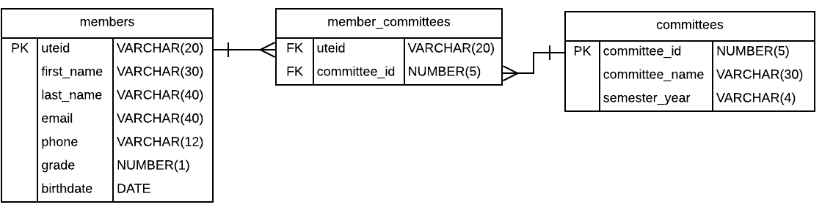
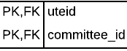
Let’s Practice: UBC Committee Track (w/o Roles)

Slide 9
Practice: Create table with column-level constraints
Task:
Create the members table with the key and data types noted in ERD and test with seeding data
Create the committees table with the key and data types noted in ERD and test
NOTE:
Always make sure your code is clean/readable
Syntax Hint:
CREATE TABLE table_name
(
column_name_1 data_type [column_constraints],
column_name_2 data_type [column_constraints]
)

Slide 10
Practice: Create tables with table-level constraints
Task:
3. Create the members_committees table with composite PKs and two FKs. This requires table-level constraints.
4. Test constraints work
Syntax Hint:
CREATE TABLE table_name
(
column_name_1 data_type [column_constraints],
column_name_2 data_type [column_constraints],
CONSTRAINT [constraint_name] PRIMARY KEY (column_name_1, column_name_2),
CONSTRAINT [constraint_name] FOREIGN KEY (fk_column) REFERENCES table (pk_column)
)

Slide 11
Practice: Add a table-level check constraint
Syntax Hint:
ALTER TABLE table_name
ADD CONSTRAINT constraint_name CHECK (column_name condition) [DISABLE];

Slide 12
Practice: Editing table components
Syntax for modifying the table columns
ALTER TABLE table_name
ADD column_name data_type [column_constraint]
DROP COLUMN column_name
MODIFY column_name data_type [column_constraint]
}
Syntax for modifying the table constraints
ALTER TABLE table_name
ADD CONSTRAINT constrnt_name definition [DISABLE]
DROP CONSTRAINT constrnt_name
ENABLE [NOVALIDATE] constrnt_name
DISABLE constrnt_name

Slide 13
Practice: Deleting table components
Drop a constraint
Drop a column
Truncate a table
Drop a table
Syntax for modifying the table columns
ALTER TABLE table_name
ADD column_name data_type [column_constraint]
DROP COLUMN column_name
MODIFY column_name data_type [column_constraint]
}
Syntax for modifying the table constraints
ALTER TABLE table_name
ADD CONSTRAINT constrnt_name definition [DISABLE]
DROP CONSTRAINT constrnt_name
ENABLE [NOVALIDATE] constrnt_name
DISABLE constrnt_name
Syntax to rename a table
RENAME table_orig_name TO table_new_name
Syntax to purge all data in a table
TRUNCATE TABLE vendor
Syntax to delete a table
DROP TABLE vendor

Slide 14
How to run
many SQL statements
in a “script”

Slide 15

Practice: Create a drop script accounts payable tables
-- Using a double dash will add a comment to your code
“EXECUTE IMMEDIATE” is used to run a string of text as a query. Not needed
“WHEN OTHER” is used for trapping errors”
Example 1
EXECUTE IMMEDIATE 'DROP TABLE invoice_archive';
EXECUTE IMMEDIATE 'DROP TABLE invoice_line_items';
EXECUTE IMMEDIATE 'DROP TABLE invoices';
EXCEPTION
WHEN OTHERS THEN
DBMS_OUTPUT.PUT_LINE('');
END;
Example 2
-- You can also run the following. Has to run as a script not as single query
DROP TABLE invoice_archive;
DROP TABLE invoice_line_items;
DROP TABLE invoices;

Slide 16
Practice: Create a drop script for your UBC tables
What order should we drop the tables?
Can’t drop “parent” table without creating orphan records so drop child table first
What order should we add the tables in a create script?
Can’t add “child” table without creating parent table so add PK table first

Slide 17
More tips & best practices to keep in mind
Cannot Combine these attributes:
PRIMARY KEY with UNIQUE
NOT NULL with DEFAULT
Make sure definitions (name, datatype) of PK and corresponding FK match
Use UPPERCASE for keywords and make sure they are spelled out correctly
Use spaces and indentation to make your code more readable
Match your parenthesis
Oracle won’t allow a change to a column if that change would cause data to be lost
Consider the order in which you create tables

Slide 18
SEQUENCES

Slide 19
Let’s Clarify:
Cycle = return to beginning of seq after it hits the max value
Cache = Saves the next set of numbers in the seq in memory to speed up performance. Default cache is 20.
Order = Guarantees the numbers generated in order of request. Only used in unique application design situations

Slide 20
In the Practice you will….
Create a sequence called member_id_seq that starts at 10 and increments by 1.
Run test INSERT statements and confirm sequence was created correctly and works
Update the DDL provided to default the member_id column to the next value of the newly created sequence
Run 2nd test INSERT statements and then confirm member_id defaults correctly
Hint: Put PK constraint at end of column definition

Slide 22
Try this if you have time!
Write a statement that looks up the Current value and next value for the member_id_seq using Dual table

Slide 23
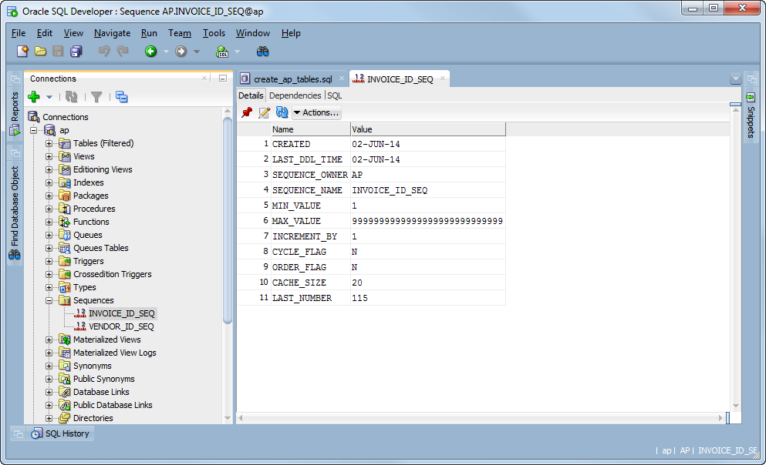

Slide 24
INDEXES

Slide 25
How to work with Indexes
Speeds up joins and searches. How? Let’s look at example
By default, Oracle creates an index on each Primary Key
Best to add Indexes on columns:
Frequently used in joins (i.e. Foreign Keys especially)
Frequently used in searches
Has a UNIQUE integrity constraint
Not updated a lot - indexes slow down insert, update, deletes
FAQ: Is indexing everything bad? Who typically makes indexes?

Slide 26
TIP: Use a standard naming convention for readability. e.g. table_column_ix

Slide 27
Practice:
1. What would be likely fields to create an index on for the invoice table?
2. Create an index on vendor_id. Why?
3. Create an index on invoice_date why? Should we consider sorting? Create index.

Slide 28
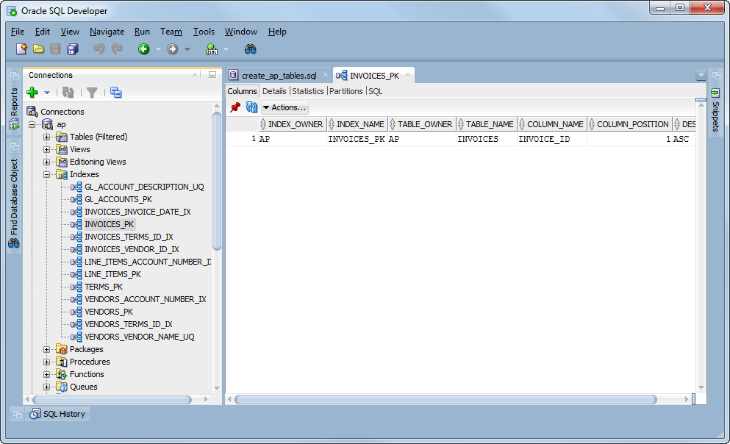

Slide 29
INSERT, UPDATE, DELETE
+
TRANSATIONS

Slide 30
INSERT statements add data to tables
INSERT INTO invoices
VALUES (115, 97, '456789', '01-AUG-14', 8344.50, 0, 0, 1, '31-AUG-14', NULL)
The response from the system
1 rows inserted
A COMMIT statement that commits the changes
COMMIT
The response from the system
COMMIT succeeded
A statement that rolls back the changes
ROLLBACK
The response from the system
ROLLBACK succeeded

Slide 31
Terms you should know
Transaction
Commit
NOTE: data isn’t officially saved to table for other users to see until you Commit.
NOTE: You’ll be able to see data you insert before a commit
Rollback
NOTE: If you rollback before you commit, data will not be saved to table

Slide 32
The syntax of the CREATE TABLE AS statement
CREATE TABLE table_name AS
SELECT select_list FROM table_source
[WHERE search_condition]
Example
CREATE TABLE invoices_copy AS
SELECT *
FROM invoices
When would this be useful?
Avoid touching production tables in a live DB
Let’s you practice on non-production tables.
NOTE: It’s not likely you’ll be creating “test” tables in a Production environment

Slide 33
Warning
When you use the SELECT statement to create a table, only the column definitions and data are copied.
Definitions of primary keys, foreign keys, indexes, default values, and so on are not included in the new table.

Slide 34
INSERT syntax for inserting a single row
INSERT INTO table_name [(column_list)]
VALUES (value_1 [, expression_2]...)
An INSERT statement that adds a new row without using a column list
INSERT INTO invoices
VALUES (115, 97, '456789', '01-AUG-14', 8344.50, 0, 0, 1, '31-AUG-14', NULL)
(1 rows inserted)
An INSERT statement that adds the new row using a column list
INSERT INTO invoices
(invoice_id, vendor_id, invoice_number, invoice_total, payment_total,
credit_total, terms_id, invoice_date, invoice_due_date)
VALUES
(115, 97, '456789', 8344.50, 0,
0, 1,'01-AUG-14', '31-AUG-14')
(1 rows inserted)
NOTE: It’s okay to continue on 2 lines

Slide 35
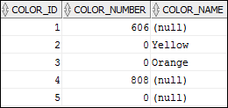

Slide 36
Commonly used when copying data from one table to another that have similar data structure.

Slide 37
Commonly used when copying data from one table to another that have similar data structure.

Slide 38
The syntax of the UPDATE statement
UPDATE table_name
SET column_name_1 = expression_1 [, column_name_2 = expression_2]...
[WHERE search_condition]
An UPDATE statement that assigns new values to two columns of a single row in the Invoices table
UPDATE invoices
SET payment_date = '21-SEP-14',
payment_total = 19351.18
WHERE invoice_number = '97/522'
(1 rows updated)

Slide 44
Questions?

